Slide 1
Predicting Guest Cancelation: A Classification Analysis of Hotel Bookings
AAI - Milan Mijailovic - 2024230373

Slide 2
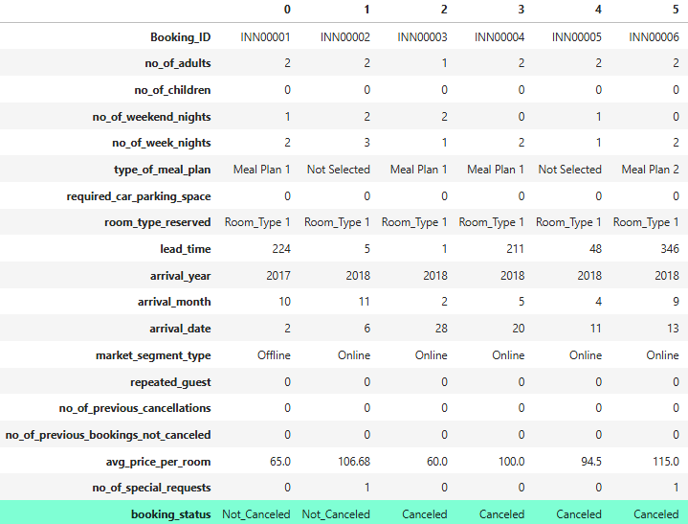
Data overview
`booking_status` is target
Target column is categorical – classification task
Snippet of dataset, transposed, target highlighted

Slide 3
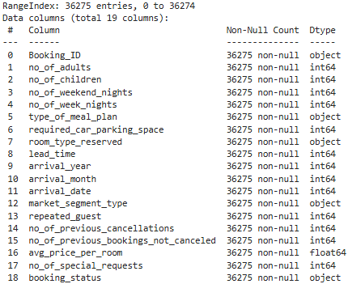
Data overview – Cleaning the data
Booking_ID removed
No NA values present
Numerical columns validated by checking min, max, and unique counts
Object columns validated by examining unique values
Everything is reasonable
All columns

Slide 4
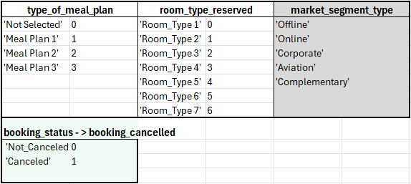
Data Encoding
Ordinal classes integer encoded to preserve order
Nominal class one-hot encoded
booking_status renamed

Slide 5
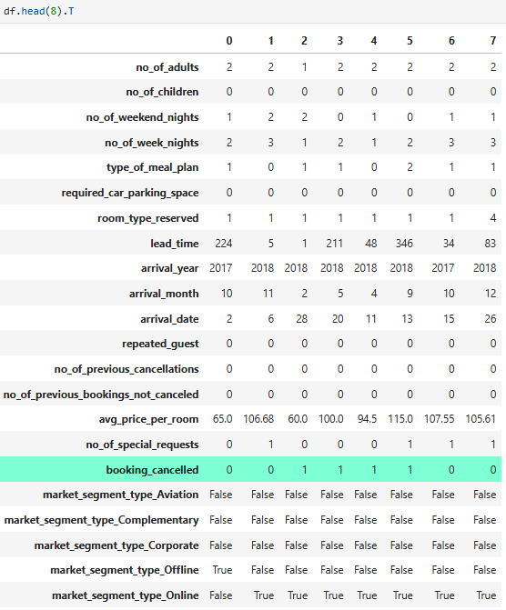
Data Encoding

Slide 6
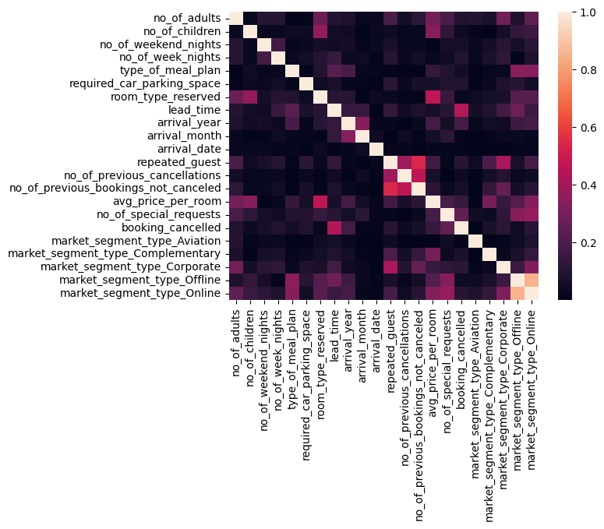
Relationships
Data Pearson correlation heatmap
Correlations shown displayed in absolute terms – interested in correlation strength not direction
Few notable correlations with booking_cancelled

Slide 7
Machine learning models
Logistic Regression
Best for simple binary classification problems where linear relationships are present
SVC (Support Vector Classifier)
Best for high dimensional, well-separated data
Decision Tree
Best for non-linear patterns
Random Forest
Comprised of many decision trees
Best at handling non-linear, complex data
K-Nearest Neighbors (KNN)
Measures Euclidian distance between data points and predicts based on closest points
Best for small datasets

Slide 8
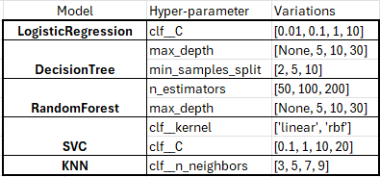
Hyper parameter tuning
Tuning performed with Grid Search
Models in Grid Search scored on accuracy
Best estimator of each model also has it’s F1 and ROC AUC scores saved for comparison
5-fold cross validation to ensure a more reliable score

Slide 9
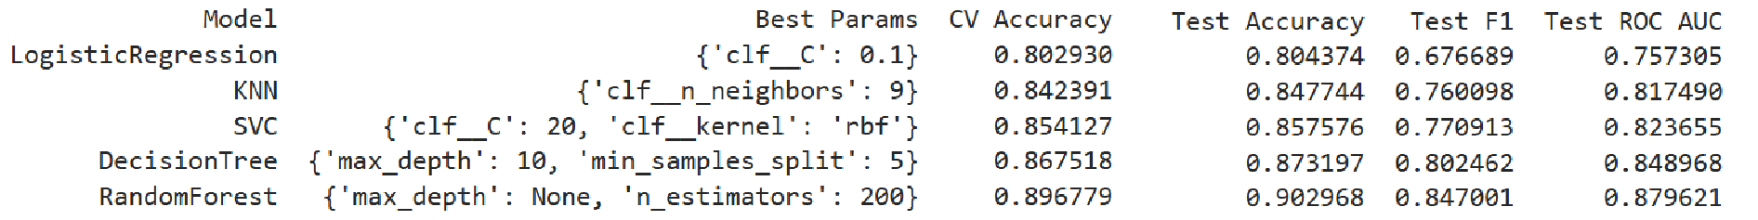
Results
Random forest performed the best across all metrics
As expected more simple models performed worse confirming the presence of more complicated relationships
An F1 score > 80 indicates strong performance, rarely missing or wrongly labelling positives

Slide 10
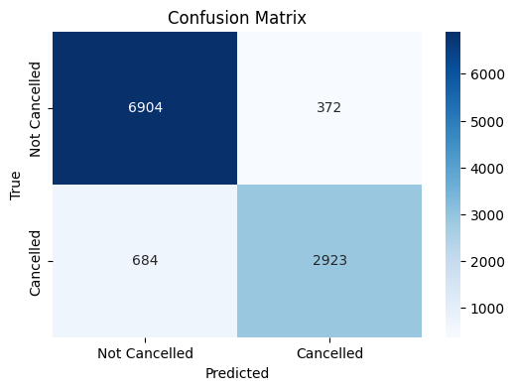
Results
For Not Cancelled predictions, the model has an error rate of 5.4%
For Cancelled predictions, the model has an error rate of 23.4%
Based on these numbers a hotel can overbook 3 reservations for every 4 predicted cancellations

Slide 11
THANK YOU for listening

